Slide 1

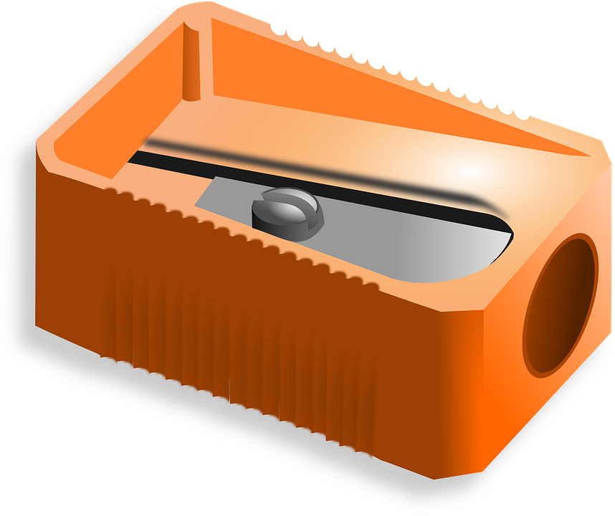
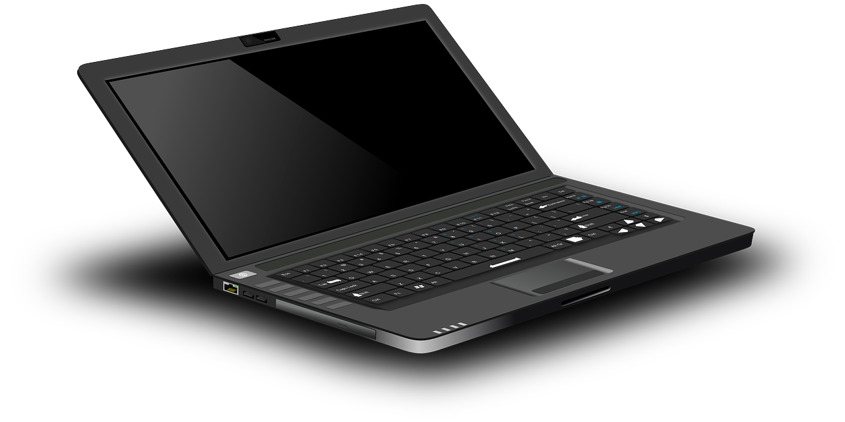
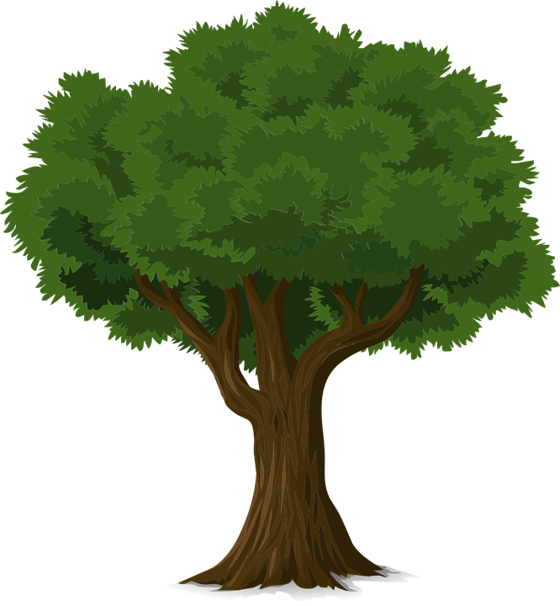

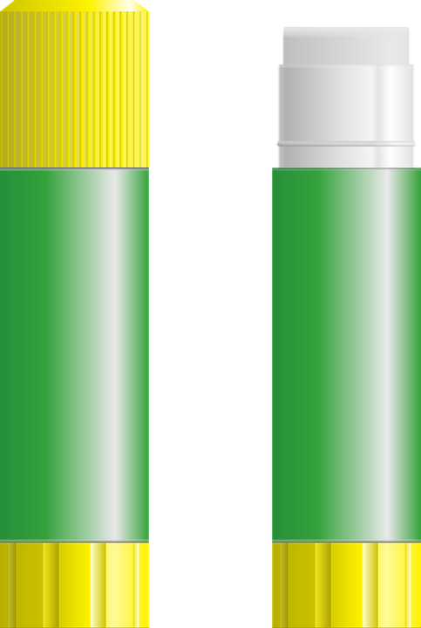

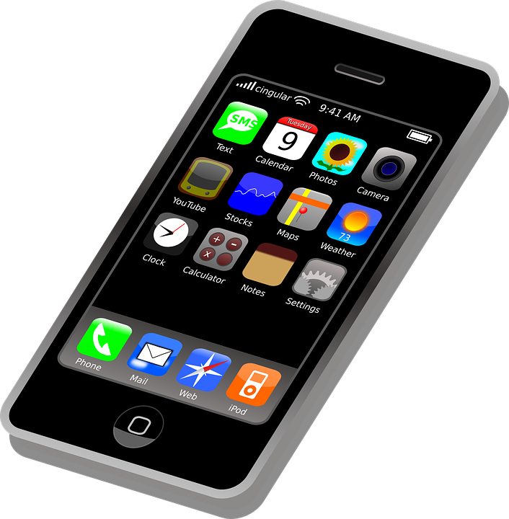

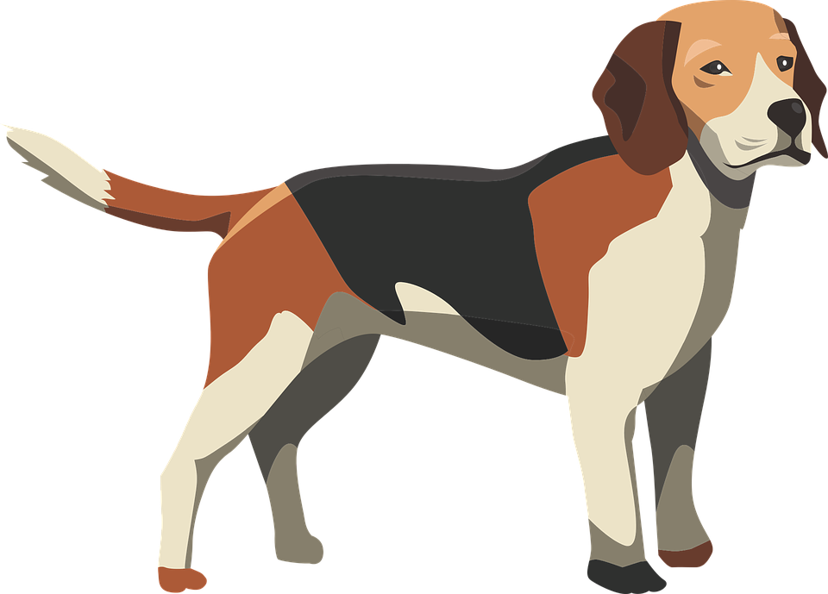


Year 1 - Technology around us
Lesson 1 – Technology in our classroom
Learner activity sheet
活动 1 解析 – 这是科技吗?
科技
不是科技
Resources are updated regularly - the latest version is available at: the-cc.io/curriculum.
This resource is licensed by the Raspberry Pi Foundation under a Creative Commons Attribution-NonCommercial-ShareAlike 4.0 International licence. To view a copy of this license, visit, see creativecommons.org/licenses/by-nc-sa/4.0/
Notes:
Last updated:03-06-21

